Slide 1
Online EHS Training
Emergency Eye Wash Station and Safety Shower
2023

Slide 2
Learning objective
Upon completion of this training course, participants will be able to:
Outline the Standards and Guidelines for emergency showers and eye wash stations
Concerns related to inspections and testing of safety showers and eyewash stations
Understand responsibilities and the need for training on emergency showers and eye wash equipment

Slide 3
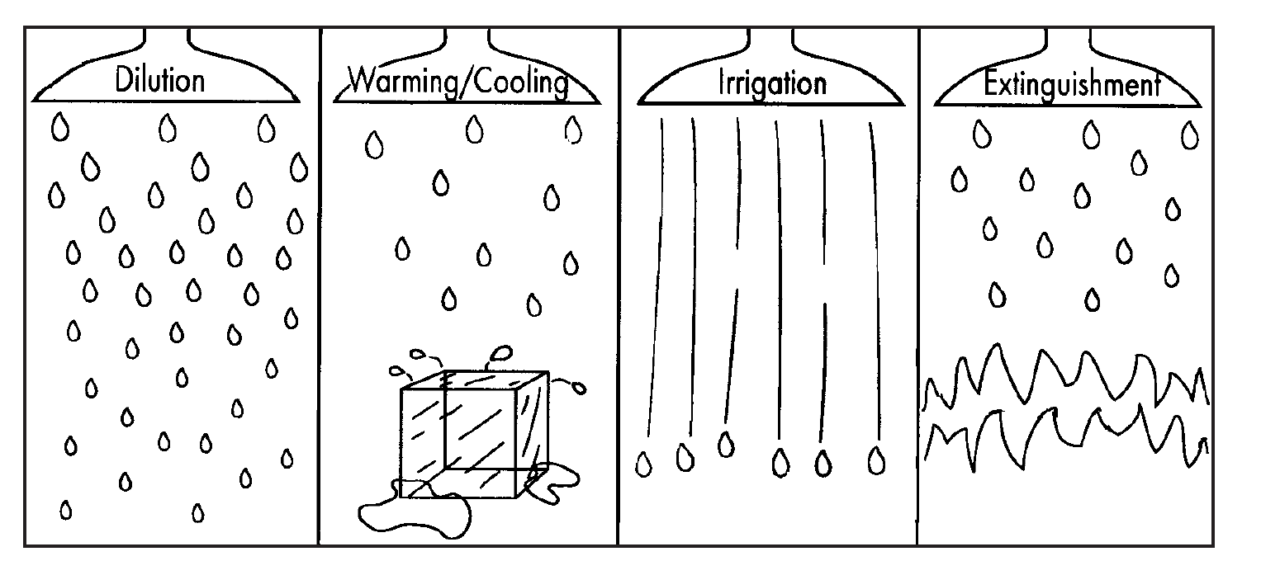
Ways of using Safety Shower/ Eyewash Station
Dilution—diluting the chemicals that are on the skin or in the eyes to a non-harmful level.
Warming/cooling—warming or cooling the body or eyes because of a change in temperature due to chemical exposure.
Irrigation—flushing the chemicals out of the eyes or off the skin.
Extinguishment—putting out fires of clothing on the body.

Slide 4
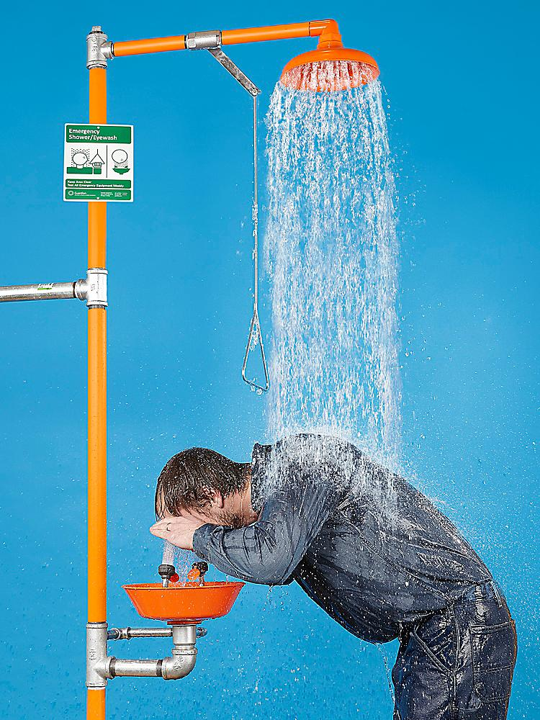
Safety Showers & Eyewash stations
Safety showers also known as deluge showers are designed to flush the user's head and body. They should not be used to flush the user's eyes because the high rate or pressure of water flow could damage the eyes in some instances.
Safety showers
designed to provide a deluge large enough to encompass the whole body.
ensures the entire body receives a direct, fresh supply of water.
use to flush the affected area for at least 10-15 minutes
water flow rate is 75.7 liters per minute
Eyewash is required where there is the potential for a lab user’s eyes to be exposed to corrosives, strong irritants, or toxic chemicals.
Eyewash must irrigate and flush both eyes simultaneously and allow the user to hold the eyes open with both hands.
Use emergency eyewash stations to flush the affected area for at least 10-15 minutes
Keep the emergency shower and eyewash area clear of obstructions

Slide 5
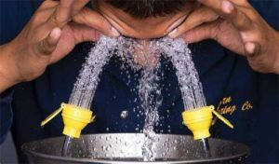
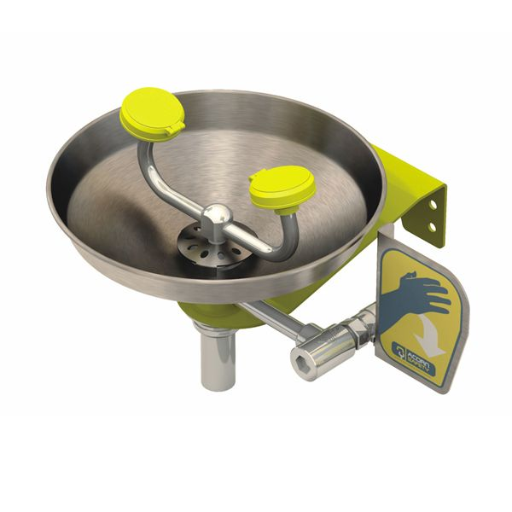
Eyewash Stations
Eyewash required where there is the potential for a lab user’s eyes to be exposed to corrosives, strong irritants, or toxic chemicals.
Eyewash must irrigate and flush both eyes simultaneously and allow the user to hold the eyes open with both hands.
Use emergency eyewash stations to flush the affected area for at least 10-15 minutes

Slide 6
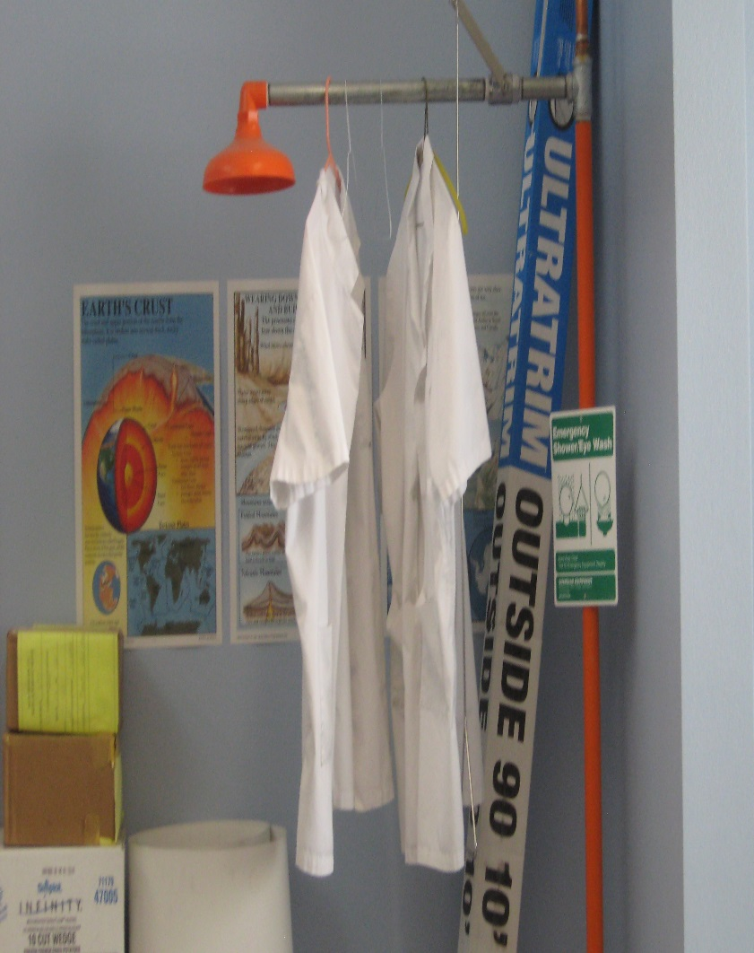
Obstructed Eyewash Stations
Safety shower and eyewash station must be free from obstacles.
Consider this scenario:
A lab user with chemical in his/her eyes, bumping into equipment, tables, clothes on hangers, storage boxes, then finding the eyewash station was not hooked up to water!

Slide 7
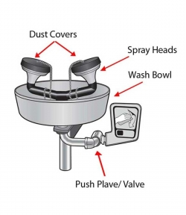
Eyewash requirements
Velocity of the stream of water must be such that injury to the eye is avoided.
Controlled flow must be provided to both eyes simultaneously.
The nozzles must be covered to prevent contamination and covers must automatically open when the unit is activated.
User must have enough room to hold both eyes open while in the stream of water.
All units should be plumbed at 210kPa and must be able to maintain a period of not less than 15 minutes.
Water flow rate required
Showers 75.7 liters per minute
Face wash 11.4 liters per minute
Eyewash 1.5 liters per minute

Slide 8
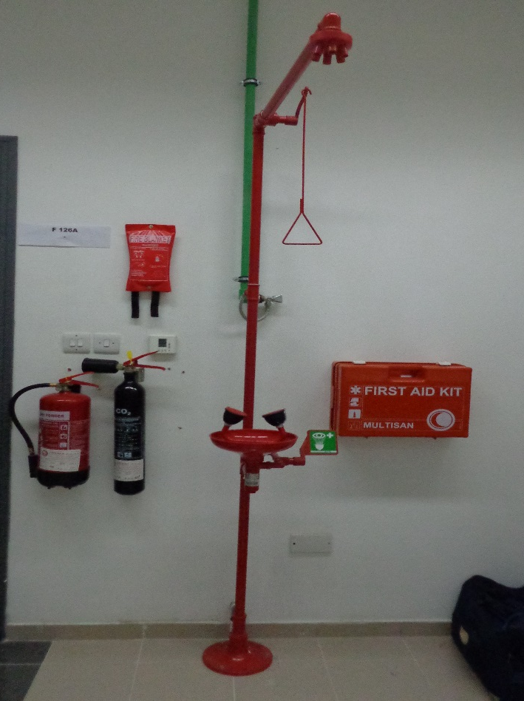
Eyewash/ Safety shower testing
Facilities Management team will performs yearly testing of safety shower/eyewash stations.
Lab custodian MUST perform monthly testing of eyewash stations. This is to ensure proper function of the eyewash station and to flush out sediment buildup and stagnant water. Ideally one should flow the eyewash for one to three minutes.
Self-contained units should be activated in accordance with the manufacturer’s directions.

Slide 9
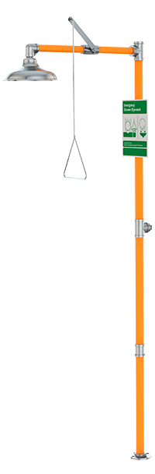
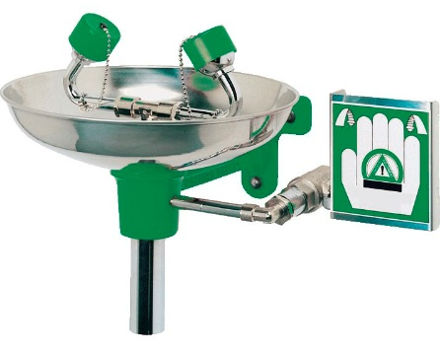
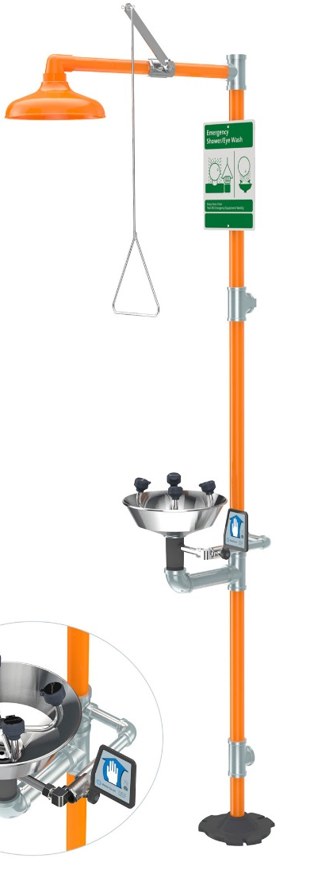
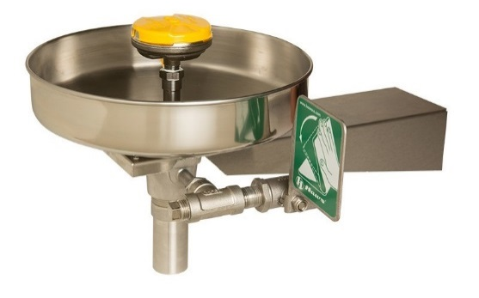
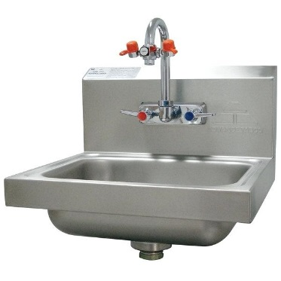
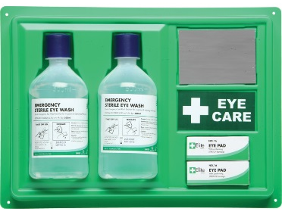
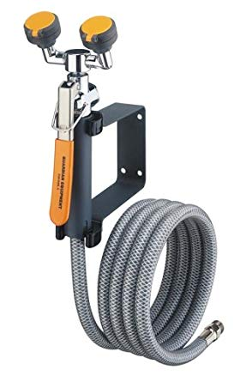
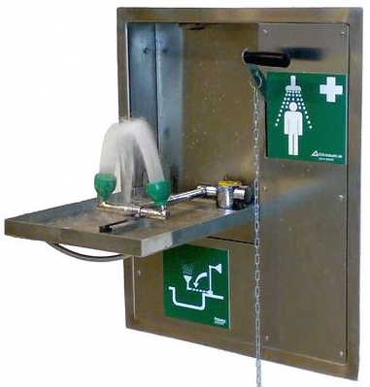
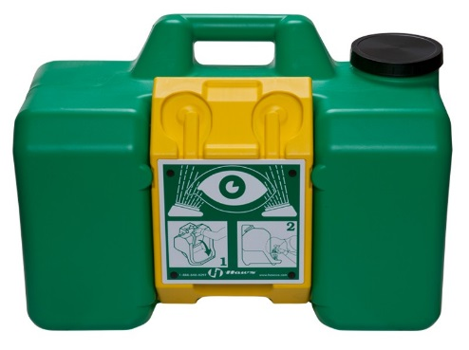
Types of Eyewash and Safety Showers
Emergency Shower
Eyewash
Facewash
Combination Units
Faucet mount Eyewash
Personnel Eyewash
Drench hose Eyewash
Wall mount Eyewash
Portable Eyewash station

Slide 10
Training to use Eyewash and Safety Shower facilities
All staff/students who might be exposed to a chemical splash must be familiarized and trained by their department or lab supervisor as part of their lab specific induction
KU Emergency eyewash station and safety shower guidelines
Learn the location and use of all emergency equipment
How to properly activate and use the emergency equipment.
Know the effects of chemicals with which he/she is working. Read and understand safety data sheets for each chemical with which lab user work.
Always wear appropriate personal protective equipment during chemical handling.
Know how to help others reach showers or eyewashes and how to help them get medical assistance.

Slide 11
Using an Eyewash Station/ Safety shower during an emergency
In case of chemical exposure, flush skin or eyes with cool water for at least 15 minutes. DO NOT RUB!
In case of eye exposure, hold eyelids open using the thumb and index finger to help ensure that effective rinsing has occurred behind the eyelid. “Roll” eyes around to ensure full rinsing.
Contact lenses must be removed as soon as possible to ensure that chemicals are not trapped behind the lenses and then the eyes can be completely rinsed of any harmful chemicals.
Remove contaminated clothing after the shower has been activated.
Immediately wash off even small amounts of chemicals.
Medical attention should be sought immediately! Ideally another person in the lab should make contact with emergency contact number 02 312 3999 for medical support. The sooner medical attention can be given, the chances of not sustaining permanent damage or blindness is greatly improved.

Slide 12
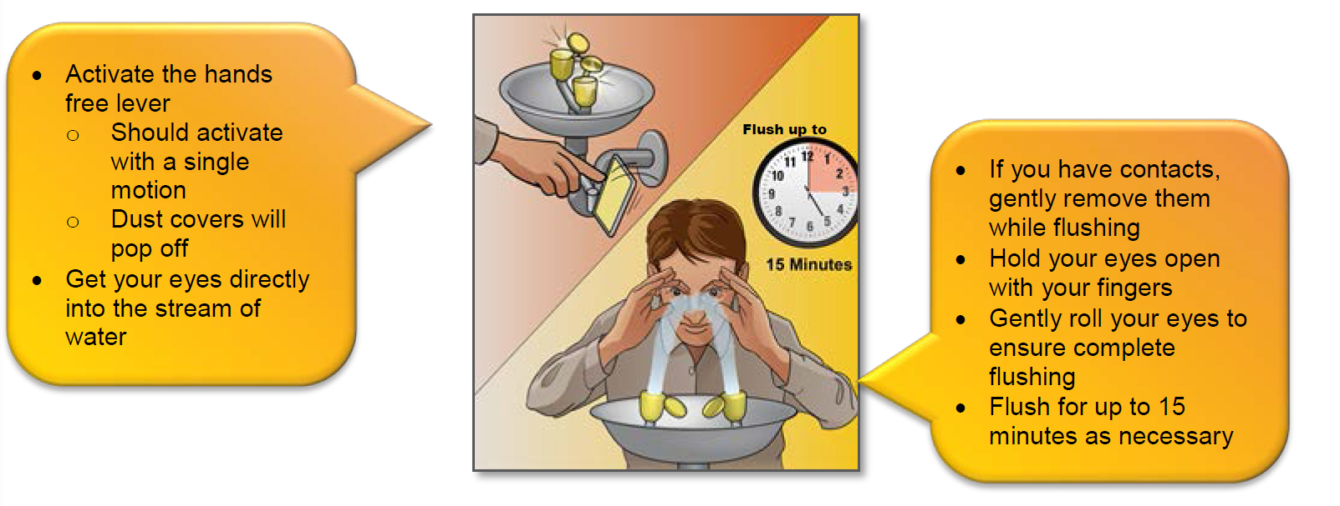
Using an Eyewash Station during an emergency

